Slide 1
University Physics: Mechanics
Lecture 9
Ch6. Friction and Centripetal Force
Dr.-Ing. Erwin Sitompul
http://zitompul.wordpress.com

Slide 2
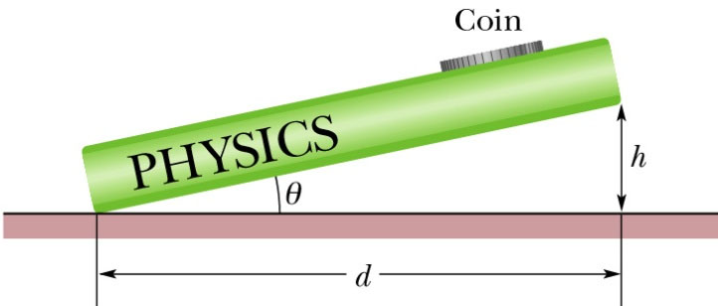
Homework 7: Coin On A Book
The figure below shows a coin of mass m at rest on a book that has been tilted at an angle θ with the horizontal. By experimenting, you find that when θ is increased to 13°, the coin is on the verge of sliding down the book, which means that even a slight increase beyond 13° produces sliding.
What is the coefficient of static friction μ_{s} between the coin and the book?
Hint: Draw the free-body diagram of the coin first.

Slide 3
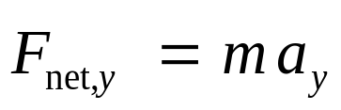



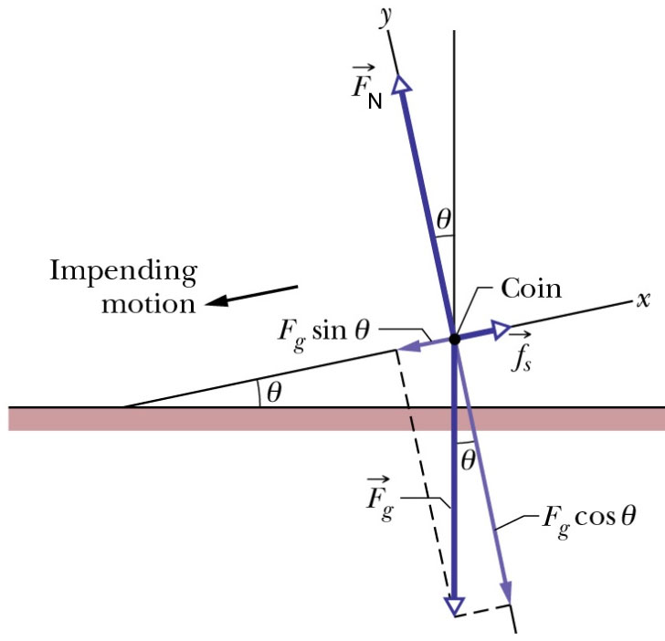
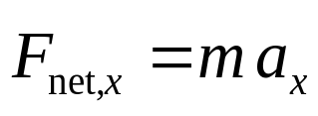



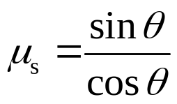
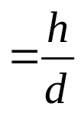



Solution of Homework 7: Coin On A Book
Forces along the y axis:
Why zero?
Forces along the x axis:
Why zero?
So, the coefficient of static friction is:

Slide 4
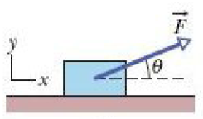
Example: Blue Block
→
A block of mass m = 3 kg slides along a floor while a force F of magnitude 12 N is applied to it at an upward angle θ. The coefficient of kinetic friction between the block and the floor is
μ_{k} = 0.4. We can vary θ from 0 to 90° (with the block remains on the floor.
What θ gives the maximum value of the block’s acceleration magnitude a?

Slide 5
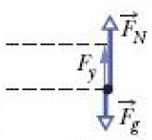
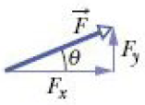
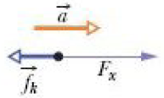
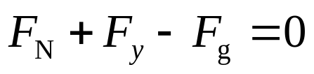
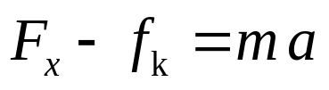
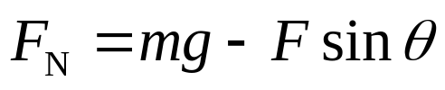
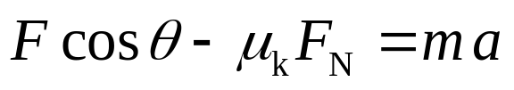
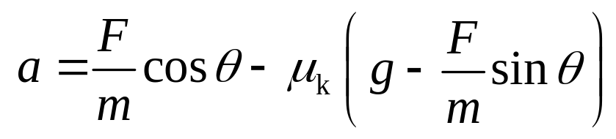
Example: Blue Block
Forces along the y axis:
Forces along the x axis:
What θ gives the maximum value of a?
da/dθ = 0

Slide 6
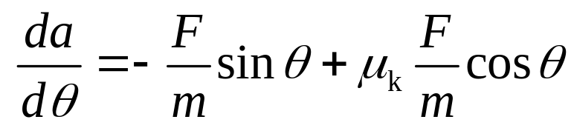

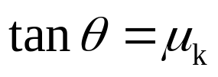
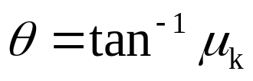
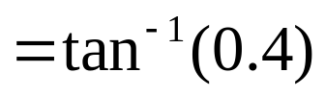
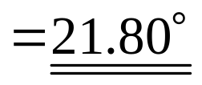
Example: Blue Block
If a is given by
then, the derivative of a with respect to θ is

Slide 7
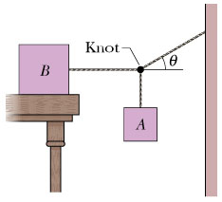
Example: Two Blocks
Block B in the figure below weighs 711 N. The coefficient of static friction between block and table is 0.25; angle θ is 30°. Assume that the cord between B and the knot is horizontal.
Find the maximum weight of block A for which the system will be stationary.

Slide 8
Example: Two Blocks
→
T_{W}
→
Wall
T_{B}
Knot
→
T_{W}
→
T_{A}
→
→
F_{NB}
T_{A}
→
→
Block A
f_{s,max}
T_{B}
→
T_{W}
Block B
→
→
→
F_{gB}
F_{gA}
f_{s,max}
Knot
→
F_{gA}

Slide 9
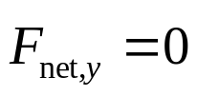


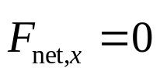
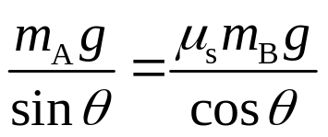


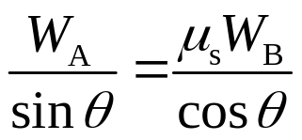




Example: Two Blocks
Forces along the y axis:
T_{Wy}
→
T_{W}
→
θ
T_{Wx}
f_{s,max}
Knot
Forces along the x axis:
→
F_{gA}

Slide 10
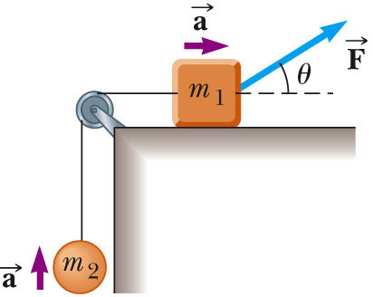
Example: Multiple Objects
A block of mass m₁ on a rough, horizontal surface is connected to a ball of mass m₂ by a lightweight cord over a lightweight, frictionless pulley as shown in the figure below.
A force of magnitude F at an angle θ with the horizontal is applied to the block as shown and the block slides to the right. The coefficient of kinetic friction between the block and surface is μ_{k}.
Find the magnitude of acceleration of the two objects.

Slide 11
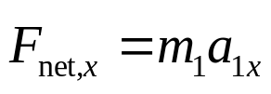



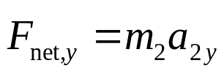





Example: Multiple Objects
F_{y}
→
→
F
F_{N}
→
θ
T
F_{x}
→
m₁
f_{k}
→
Forces in m₁
→
F_{g1}
T
Forces in m₂
m₂
→
F_{g2}

Slide 12
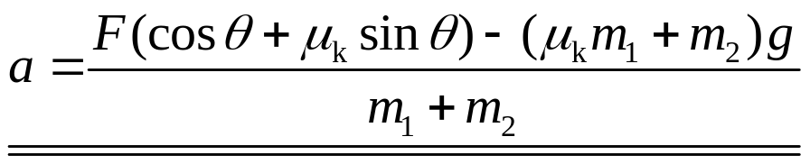
Example: Multiple Objects

Slide 13
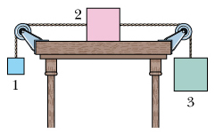
Example: Trio Blocks
When the three blocks in the figure below are released from rest, they accelerate with a magnitude of 0.5 m/s². Block 1 has mass M, block 2 has 2M, and block 3 has 2M.
What is the coefficient of kinetic friction between block 2 and the table?

Slide 14
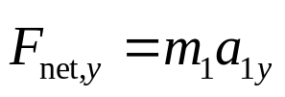
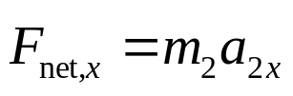






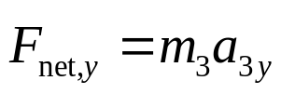


Example: Trio Blocks
a
Forces in m₁
Forces in m₂
a
a
→
→
F_{N}
T₂
→
T₁
→
→
T₁
T₂
m₁
m₂
m₃
Forces in m₃
→
f_{k}
→
F_{g1}
→
→
F_{g2}
F_{g3}

Slide 15
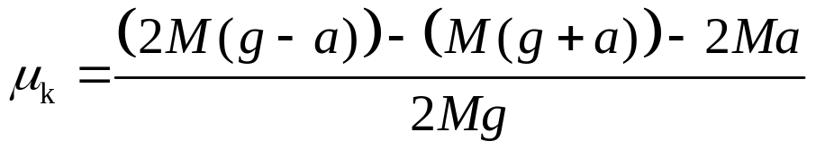
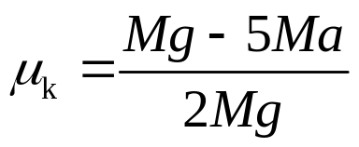
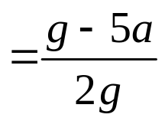
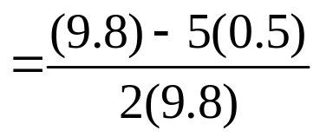
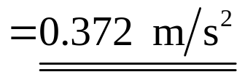
Example: Trio Blocks

